Slide 1
Proposed CEQA Guidelines
AEP Institute
August 4, 2017

Slide 2
Background
California Environmental Quality Act (Pub. Resources Code §§ 21000 et seq.)
  Guidelines for public agencies on implementation (14 CCR 15000 et seq.)
  Developed by OPR, adopted by Natural Resources Agency
  Review for updates every two years

Slide 3
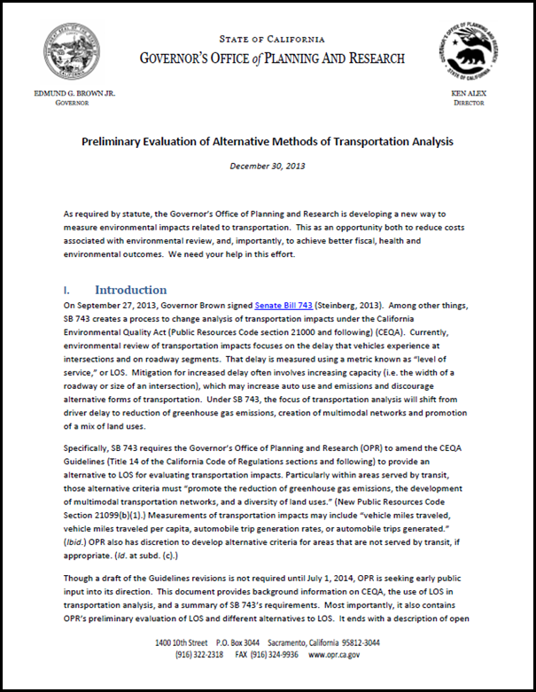
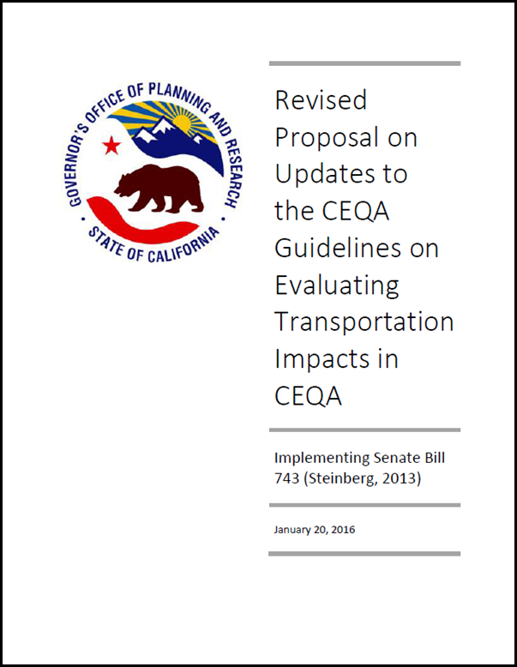
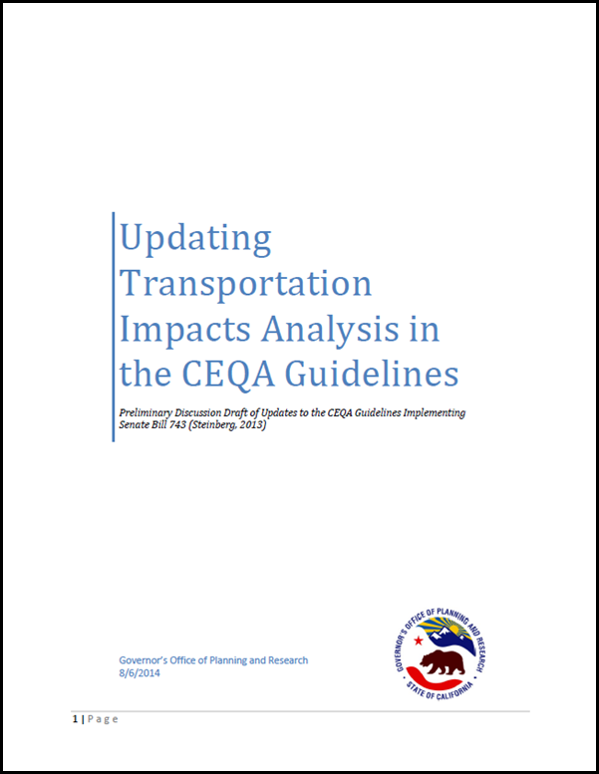
Process in Updating the Guidelines
Notes:
OPR began soliciting input – 2013
Preliminary Discussion Draft – August 2014
Preliminary Draft Guidelines – January 2016

Slide 4
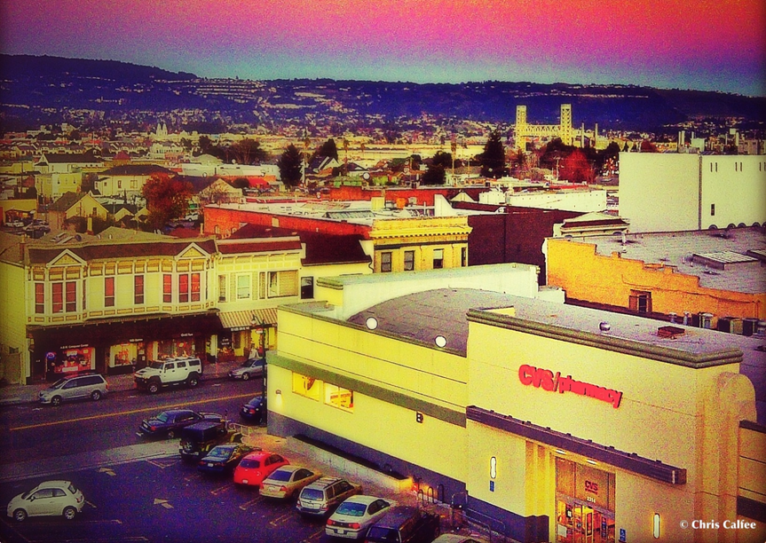
Objectives of CEQA Guidelines Update
Make CEQA review more efficient and meaningful
Reflect administration priorities
Conform to statutory changes to CEQA and cases interpreting CEQA

Slide 5
What is part of the proposed update?
Process Improvements
Regulatory Standards and Thresholds
Program EIR scope, Tiering
Substance Improvements
Energy Impacts
Technical Improvements
Baseline
Hazards
TOD Exemption
Existing Facilities Exemption
Appendix G rewrite
Remedies and Remand
Water Supply
Transportation (SB 743)
Deferred Mitigation Detail
Responses to Comment
Notes:
Comprehensive Update – most significant update since 1998
Key Pieces
Tribal Cultural Resources
Hazards
Transportation Analysis (required by SB 743)

Slide 6

What SB 743 Does
  CEQA streamlining for certain projects in Specific Plans in TPAs
  Allows local jurisdictions to establish Infill Opportunity Zones where LOS does not apply under Congestion Management law
≤ 15 min headway
Specific Plans Streamlined
+
Infill Opportunity Zones
½ Mi.
≤ 15 min headway
Notes:
Align with GHG, infill, Complete Streets

Slide 7

What SB 743 Does
  CEQA streamlining for certain projects in Specific Plans in TPAs
  Allows local jurisdictions to establish Infill Opportunity Zones where LOS does not apply under Congestion Management law
  Kings Arena
Notes:
Align with GHG, infill, Complete Streets

Slide 8
What SB 743 Does
  CEQA streamlining for certain projects in Specific Plans in TPAs
  Allows local jurisdictions to establish Infill Opportunity Zones where LOS does not apply under Congestion Management law
  Kings Arena
  Directs OPR to update transportation metrics in CEQA
    Replace LOS with new criteria in the CEQA Guidelines
    Auto delay ≠ environmental impact
Notes:
Align with GHG, infill, Complete Streets

Slide 9
Proposed CEQA Guideline section 15064.3
  Preliminary Draft - 2016
  VMT is the primary metric
  Possibly less than significant:
    Development near transit
    VMT reducing projects
  Induced travel from transportation capacity additions
  Agencies will have an opt-in period to prepare for the transition

Slide 10
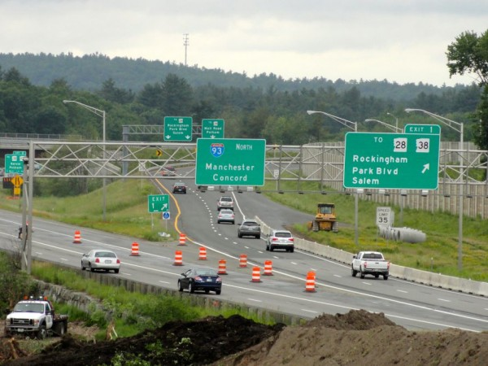
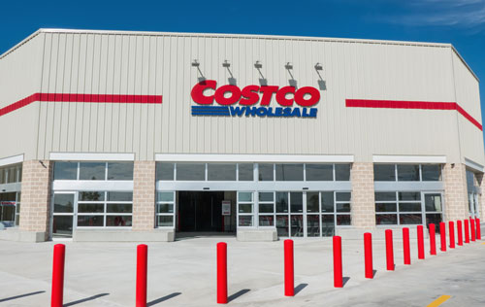
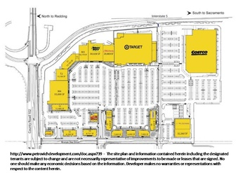
VMT in Case Law
NEPA
  Conservation Law Fdn. v. FHA (2007) 630 F. Supp. 2d 183
CEQA
  Cal. Clean Energy Comm. v. Woodland (2014) 225 Cal.App.4th 173
  Ukiah Citizens for Safety First v. City of Ukiah (2016) 248 Cal.App.4th 256
  Cleveland Nat’l Forest Fdn. v. SANDAG (2017) _ Cal.App.5th _

Slide 11
Proposed CEQA Guidelines –
Process Moving Forward
OPR
Resources Agency
Office of Administrative Law
OPR submits draft CEQA Guidelines to Resources Agency
Formal rulemaking starts
OAL reviews the Guidelines package
Notes:
OPR will submit the draft to the Natural Resources Agency, which will then commence a formal rulemaking process. Once the Natural Resources Agency adopts the changes, they will undergo review by the Office of Administrative Law.

Slide 12

Questions?
Jeannie.Lee@opr.ca.gov
Source: Google Images
Notes:
Source: Baidu

