Slide 1
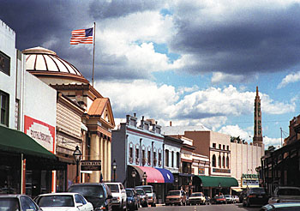
SB 743 Implementation Considerations in Rural Counties

Slide 2
In California there are 18 federally designated Metropolitan Planning Organizations (MPOs) and 26 state statutorily created Regional Transportation Planning Agencies (RTPAs) that conduct transportation planning, programming, and prepare Regional Transportation Plans. Both MPOs and RTPAs were created in order to ensure that existing and future expenditures for transportation projects and programs were based on a continuing, cooperative, and comprehensive planning process.

Slide 3
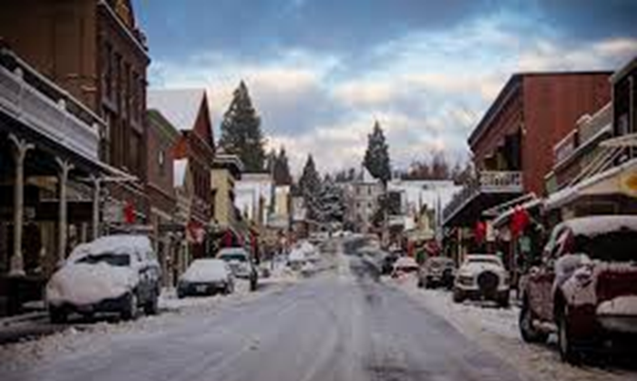
Urban and Rural Differences
Federal legislation passed in the early 1970’s required the formation of an Metropolitan Planning Organizations (MPO) for any urbanized area with a population greater than 50,000. The eighteen designated MPOs in California account for approximately 94% of the state’s population (excluding the county populations for El Dorado, Placer, Monterey, Santa Cruz, and San Benito)
The 26 designated Rural Regional Transportation Planning Agencies (RTPA), cover rural counties that generally have populations of less than 250,000 and do not have a single urbanized area greater than 50,000, and represent the other 6% of the state’s population.
Although the 26 rural counties have only approximately 6% of the states total population these counties cover 41.5% of the state’s total land area, have over 12,426 centerline state highway miles and own and maintain 24,000 centerline miles of local streets and roads. Many of these counties are also home to many of the state’s most popular recreation and tourism sites.

Slide 4
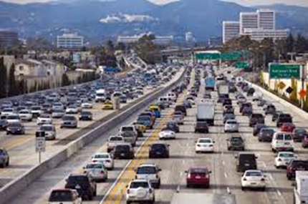
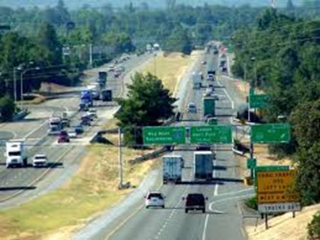
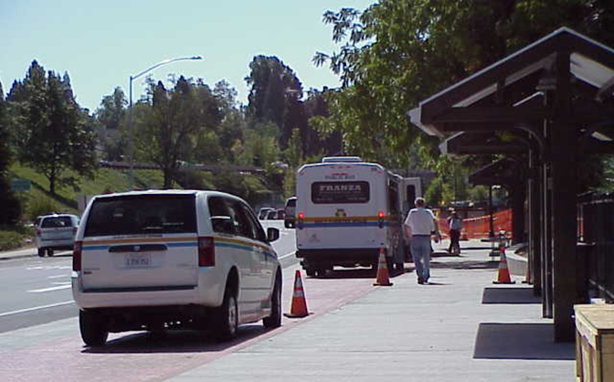
Urban and Rural Differences
SB 375 expanded the regional planning responsibilities for California MPOs, including the requirement for the development of Sustainable Communities Strategies (SCS) to demonstrate how the GHG emission targets set by the California Air Resources Board (CARB) can be achieved for the MPO region.
Rural RTPAs were not folded into SB 375 mainly because the associated costs and technical challenges related to the development of SCSs out weighed the benefits of implementation in rural areas in relation to GHG reductions.
MPOs are federally required to develop and maintain travel demand models.
RTPAs are not federally required to develop and maintain travel demand models. The majority of larger rural RTPAS have travel demand models, but many of the smaller rural RTPAs do not.
Although rural counties have public transit services that play an important role for mobility, none have headways that meet the definition of a transit priority area and major transit stops (every 15 minutes)

Slide 5
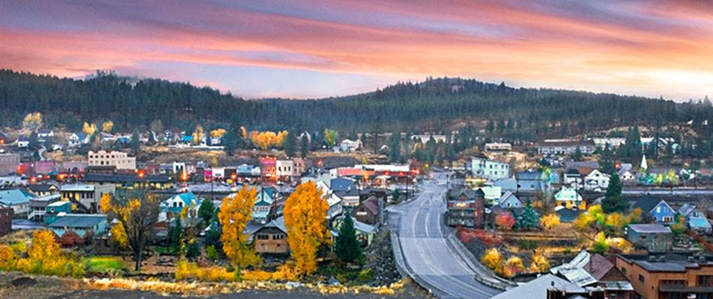
Implementation of SB 743 in Rural California
Coordinated Planning Between Regional Transportation Planning Agencies and Local Jurisdictions. RTPAs are in a position to take the lead to initiate a coordinated planning process with the local jurisdictions in their regions to help implement.
Establishment of Thresholds that Align with General Plans. In looking at the different methodologies and considering VMT thresholds it will be important for cities and counties to review their general plan to ensure that they establish thresholds that are consistent with their general plan goals, while meeting the intent of SB 743
Notes:
Coordinated Planning - In the 26 rural counties the RTPAs are probably best suited to take the lead role in funding the studies necessary analyze the different approaches and methodologies to help guide implementation of SB 743 in the cities and counties within their jurisdiction. If may be a challenge for all 26 rural counties to implement SB 743 within the 2-year opt in period, but several are starting a coordinated planning process this year.
Establish Thresholds that Align with General Plan Goals In looking at the different methodologies and considering VMT thresholds it will be important for cities and counties to review their general plan to ensure that they establish a threshold that is consistent with their general plan goals, while meeting the intent of SB 743. Rural cities and counties will need to determine what are appropriate thresholds and can either use the recommended OPR Guidelines VMT Thresholds or decide to establish jurisdiction-specific project and plan level VMT thresholds.

Slide 6
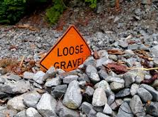
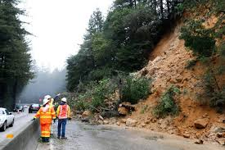
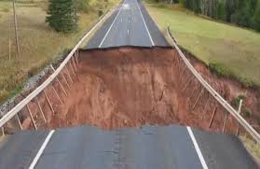
Potential Challenges in Rural California
Areas without Travel Demand Models. For these areas they will need to rely on data from either the Caltrans California Statewide Travel Demand Model, California Household Travel Survey Data, or other available sources to identify trip lengths by land use type for the region that can be multiplied by traffic volumes. Project VMT may need to be qualitative and input into one of the various VMT sketch models (MXD+/Main Street, CalEEMod, TDM+, etc.)
Limited Funding Available for Smaller Rural Counties and Cities. Coordination with the RTPA for the region is encouraged, since these agencies tend to have more funding sources for planning studies, such as Rural Planning Assistance and are familiar with other Caltrans grant opportunities and grant administration requirements (i.e. SB-1 Sustainable Transportation Grants). Counties and cities are also eligible to apply.
VMT Mitigation. The California Air Pollution Control Officers Association’s (CAPCOA) guide on Quantifying Greenhouse Gas Mitigation Measures acknowledges that there are limited empirical studies available to suggest appropriate VMT reduction caps for strategies implemented in rural areas. There also tend to be less applicable VMT mitigation measures.
Notes:
VMT Mitigation: Due to the limited empirical data in the rural context, rural jurisdictions can use the CAPCOA guidance to help calculate the project-specific VMT reduction estimates, but may need to use professional judgement to determine the appropriate caps for the specific mitigation measures based on the regional or local setting.

Slide 7
Potential Challenges cont.
Need for Education and Outreach. Workshops could be facilitated by agencies or groups such as, Caltrans, California State Association of Counties, California League of Cities, and groups such as the Rural Counties Task Force.
Two Year Opt In Period. It still may be challenging for some of the smaller regions to conduct the studies and implement VMT thresholds in this time frame.
Notes:
Need for Education and Outreach: Many of the rural RTPAs, counties, and cities realize they need to begin moving toward the shift to VMT CEQA analysis as a result of SB 743, but may not fully understand the steps necessary to implement the change.
2-Year Opt In: Once the guidelines are adopted the clock will start and to my knowledge there are only three of the 26 rural RTPAs that have SB 743 Implementation planning studies in there FY 2017/18 Overall work program with the intent of coordinating the development of thresholds with the jurisdictions in their region. So I think it really emphasizes the need to conduct the education and outreach efforts so the remaining 23 rural RTPAs can coordinate with their jurisdictions and take advantage of additional SB-1 Sustainable Planning Grant funding opportunities.

Slide 8
Implementation 30,000’ Level View
Key steps to for agencies to consider for implementation of SB 743:
1. Establishing baseline average VMT levels (based on observed data or travel forecasting models, CA household travel survey data, or Caltrans Statewide Traffic Model)
2. Consideration of the feasible mitigation measures for the region and determine the amount of VMT reductions that can realistically be achieved by a project
3. Determine which VMT analysis method to utilize for establishing thresholds (per capita, per employee, per service population, or other)
4. Setting appropriate VMT thresholds for projects. It would also be beneficial to develop screening maps to help identify projects that will not need a detailed VMT analysis
5. Defining the methodology for how a projects VMT generation will be estimated
6. Thresholds should be supported by substantial evidence and consider the objectives of SB 743: reduce GHGs, encourage infill development, and promote active transportation
Notes:
2. In the rural areas it will be important to identify the VMT mitigation measures that are applicable for projects and to determine the amount of reductions that are achievable for a project. Although, the CAPCOA and other guidance indicate that a 15% VMT mitigation can be achieved by most projects in most area types, in a rural county if it is determined that the applicable mitigation measures would only be able to reduce VMT 12% for example, that should be taken into account when establishing the VMT thresholds.

Slide 9
Ground Level Considerations as Part of Establishment of VMT Thresholds – What is the Right Metric?
For the VMT analysis regions will want to be able to track traffic volumes by trip purpose with their travel demand model in order to analyze different VMT scenarios.
The modeled baseline VMT does not change, but there are several different ways to analyze VMT when considering developing a threshold for a region.
Examples Include: VMT per capita, residential VMT per capita, VMT per employee, and VMT per service population (population & employment).
Depending on the unique land use characteristics of different regions it is important to compare different VMT analysis methods to determine the one that most accurately reflects the VMT.

Slide 10
Appropriate Level Detail to Understand VMT Characteristics
When you look at VMT at the larger regional level it may not depict the real VMT picture

Slide 11
The “VMT” is in the Details
At a smaller scale the VMT interactions become more apparent
Within Fee Boundary 1 the areas located along the major transportation facilities with a mix of land uses have a lower VMT average

Slide 12
“VMT Project Effect” Considerations
Based on the location and type of project proposed, consideration may need to be given for a projects VMT reducing effects
In rural areas, larger office projects that improve jobs/housing ratio balance may act to reduce VMT if they provide jobs for local residents who may otherwise have to commute longer distances
Retail projects in rural areas lacking in retail options may actually reduce VMT by keeping “shopping local”.
Project VMT analysis will need to examine the geographic market area to determine if the project is local-serving or regional-serving and determine if there is a net VMT increase above or decrease below the regional or sub-regional average.

Slide 13
Consideration of Sub-Regional VMT Thresholds
Rural areas tend to have geographically dispersed population centers with distinctly different traffic sheds and Vehicle Miles Traveled (VMT) trip characteristics. In some cases it may be logical to establish defined geographic sub-regional VMT average thresholds in certain unincorporated areas.
In Nevada County for example western Nevada County is separated from eastern Nevada County by the Sierra Nevada Mountains and both have distinctly different traffic sheds.
The densest residential areas are the incorporated communities of Grass Valley (population 12,955), Nevada City (population 3,260) and Truckee (population 15,370). The major portion of the County’s employment is centered in Grass Valley and Nevada City, with other significant employment, including many recreation industry jobs, found near the Truckee area. There are also several unincorporated established communities that range in population from 1,621 to 6,911.
The total county population is 98,095 and only 31,585 (32 percent) live in the three incorporated cities, while 66,510 (68 percent) live in other unincorporated areas of the County, illustrating the essential rural nature of the County as a whole.

Slide 14
Possible Sub-Regional Threshold Areas

Slide 15
Goals and Desired Outcomes of NCTC’s FY 17/18 Coordinated VMT Threshold Planning Effort
Identify General Plan policies and strategies that will support implementation of the VMT thresholds
Analyze the different methods for measuring VMT and determine preferred VMT measure for identifying thresholds
Review regional travel demand models to ensure consistent methodology can be used
Determine the appropriate regional and sub-regional VMT threshold boundaries
Analyze methodologies for calculating VMT reductions for applicable mitigation measures
Develop recommended methodologies, thresholds, and VMT screening maps for each jurisdiction
Notes:
This fiscal year starting in September, NCTC will be conducting a coordinated planning effort with participation from the local jurisdictions to assist them in the development and implementation of SB 743 VMT thresholds. The Goals and desired outcomes of the process are:

Slide 16
SB 743 Requires Consideration of Induced Demand in Relation to Transportation Improvements
In assessing the significance of induced demand for larger rural highway and roadway improvement projects environmental planners should ask the following questions:
Is there significant congestion on the roadway or highway under existing conditions?
Is significant economic and population growth expected in the 20 year planning period?
Is the project likely to generate substantial travel time reductions?
Are the parcels surrounding the project conducive to new development or does the zoning adjacent to the project allow for additional large scale development?
Are there alternative modes of travel in the corridor that are a viable alternative and competitive with the existing and proposed auto travel times?
If most of the answers to these questions are “no” then the proposed project would most likely not be anticipated to result in a significant amount of induced demand in the short or long-term.

Slide 17
Induced Demand in Rural Areas
Established Travel Patterns. Each project and location is unique. When you look at the application of induced demand in a rural county, due to sparse geography and terrain, the travel patterns tend be more established and static as compared to urban areas, parallel facilities often do not exist, and adding additional capacity to a roadway or highway in a rural area would not necessarily result in a large increase in VMT and trips being made on the expanded facility.
Low Mode Split. The current mode split for alternative modes of transportation in rural areas is generally low and the longer distances between destinations and terrain tend to limit bicycling and walking as viable alternatives to the automobile. Also, due to funding constraints, transit in rural areas although it is available, is limited in its coverage and frequency and is usually not a convenient alternative to the automobile.
Case by Case Analysis. The OPR Guidelines acknowledge these differences and allow for reasonable consideration and analysis on a case by case basis of induced demand for rural transportation improvement projects.

Slide 18
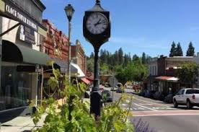
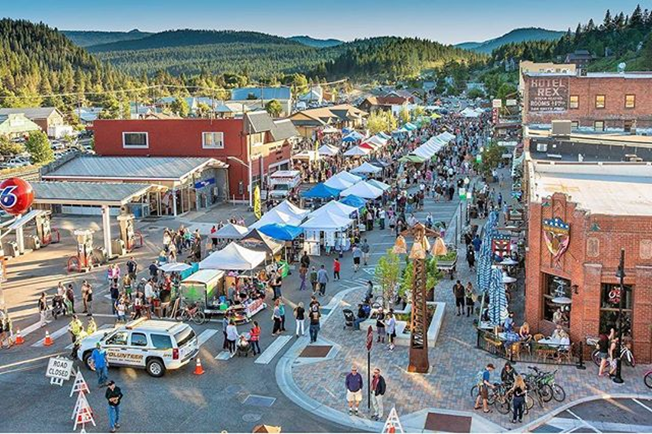
Benefits of SB 743 Implementation in Rural California
Focus development in areas of the region that have lower than average vehicle miles traveled
Promote infill within incorporated cities
Encourage mixed used development with enhanced transit, bicycle, and pedestrian access and infrastructure
Help to address the lack of affordable housing in many rural areas
Help to improve safety for pedestrian and bicycle users
Notes:
I am really looking forward to moving ahead with the studies to implement SB 743 in Nevada County and I think it will be a very interesting process. I look forward to hearing more from some of our speakers that have already implemented the establishment of VMT thresholds in their jurisdiction or region. I am happy to answer any questions.

Slide 19
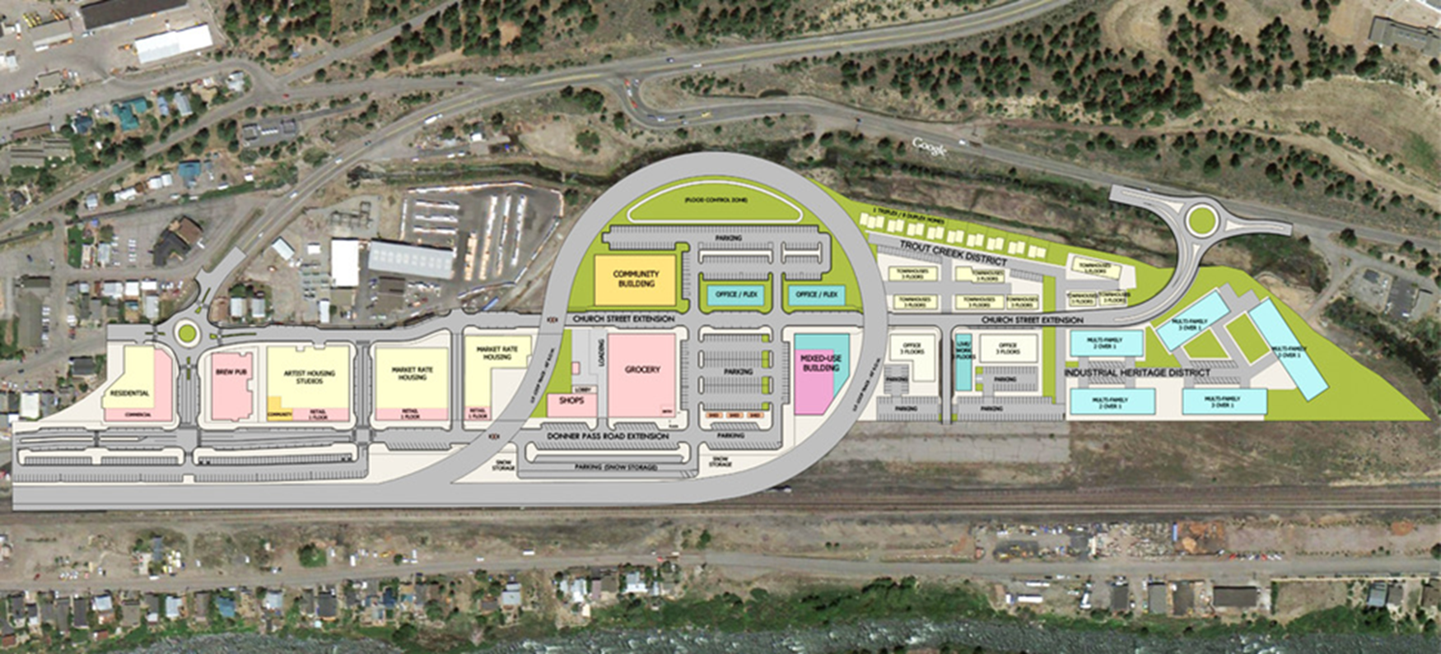
Questions?
Proposed Truckee Railyard Mixed Use Development

