Slide 1
CBIA vs. BAAQMD
Bridging The Gap Between Holding And Practice

Slide 2
Panelists
Linda C. Klein, Cox, Castle & Nicholson LLP
Scott Gregory, Lamphier Gregory
Doug Carstens, Chatten-Brown & Carstens LLP
Curtis E. Alling, AICP, Ascent Environmental

Slide 3
BAAQMD’s Action
In 2010, the Air District adopted new CEQA significance thresholds including TAC “receptor thresholds” and thresholds for PM_{2.5} (particulate matter with a diameter of 2.5 microns or less).

Slide 4
The Issue
Under what circumstances, if any, does the California Environmental Quality Act (Pub. Resources Code, § 21000 et seq.) require an analysis of how existing environmental conditions will impact future residents or users (receptors) of a proposed project?

Slide 5
The Act
CEQA provides that “a project may have a ‘significant effect on the environment’” (§ 21083(b)) if “[t]he environmental effects of a project will cause substantial adverse effects on human beings, either directly or indirectly.” (§ 21083(b)(3).)

Slide 6
Holding
CEQA generally does not require an analysis of how existing environmental conditions will impact a project’s future users or residents.
When a proposed project risks exacerbating those environmental hazards or conditions that already exist, an agency must analyze the potential impact of such hazards on future residents or users. In those specific instances, it is the project's impact on the environment — and not the environment's impact on the project — that compels an evaluation of how future residents or users could be affected by exacerbated conditions.

Slide 7
Few Exceptions
Few exceptions to the general rule: specific contexts involving certain airport (§ 21096) and school construction projects (§ 21151.8), and some housing development projects (§§ 21159.21, subds. (f), (h), 21159.22, subds. (a), (b)(3) [agricultural employee housing], 21159.23, subd. (a)(2)(A) [housing affordable to low-income residents], 21159.24, subd. (a)(1), (3) [infill housing], 21155.1, subd. (a)(4), (6) [transit priority]).

Slide 8
Holding
Court also upholds the following sentences of 15126.2(a):
The EIR shall also analyze any significant environmental effects the project might cause by bringing development and people into the area affected. . . . Similarly, the EIR should evaluate any potentially significant impacts of locating development in other areas susceptible to hazardous conditions (e.g., floodplains, coastlines, wildfire risk areas) as identified in authoritative hazard maps, risk assessments or in land use plans addressing such hazards areas.

Slide 9
Reasons
Sentences are valid to the extent they call for evaluating a project’s potentially significant exacerbating effects on existing environmental hazards — effects that arise because the project brings “development and people into the area affected.”
Both CEQA and the Guideline call explicitly for an analysis of a project’s effects on the environment.

Slide 10
Test
Section 15126.2(a) also states: “[A]n EIR on a subdivision astride an active fault line should identify as a significant effect the seismic hazard to future occupants of the subdivision. The subdivision would have the effect of attracting people to the location and exposing them to the hazards found there.”
Valid or not?

Slide 11
Meaning of “Environment”
Do you think CBIA vs. BAAQMD changed CEQA’s definition of “environment”? If so, have you changed your analysis in CEQA documents?

Slide 12
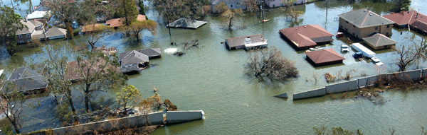
Existing Hazards
Do you feel that topics on future project inhabitants’ exposure to existing hazards (floods, earthquakes, etc.) can be omitted from CEQA documents?

Slide 13
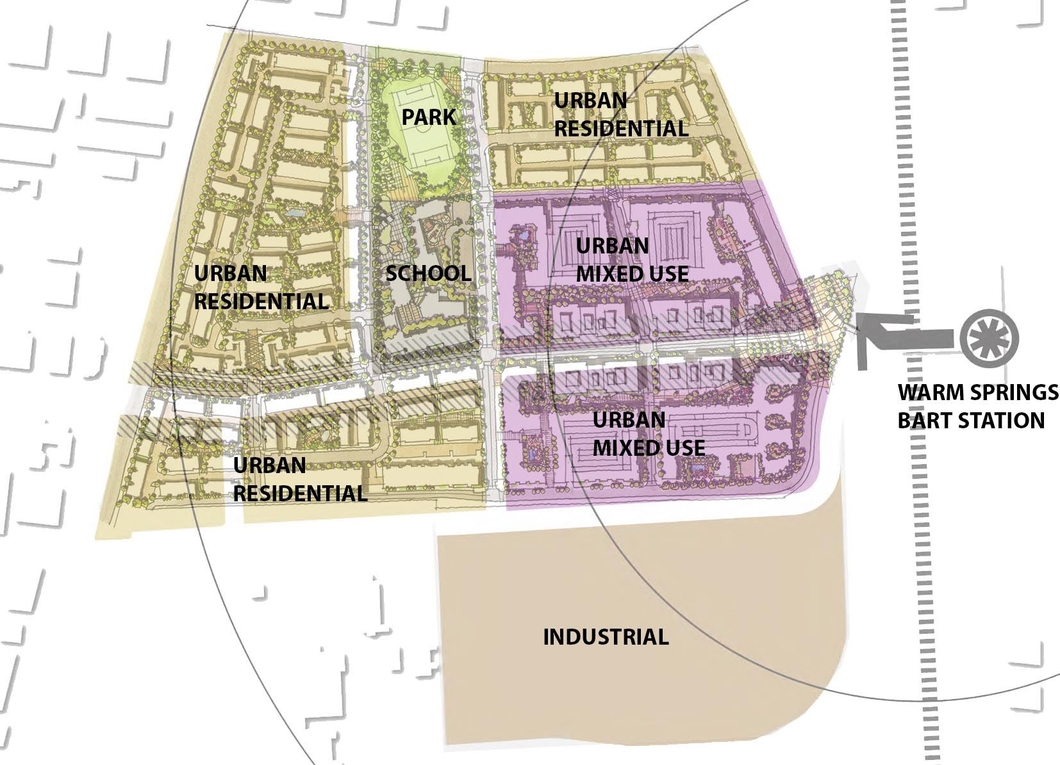
Phased Projects
How do you analyze phased projects? For example, are residents of the first phase part of the “environment” or part of the “project” for the analysis?

Slide 14
Exacerbate
Using a specific example, discuss how you interpret “risks exacerbating” an existing hazard or condition and how analysis of exacerbation of existing hazards differs from a cumulative impact analysis.

Slide 15
Advice for Planning Documents
Have you changed how you advise agency clients during updates to planning documents such as General Plans, Climate Action Plans, etc.?

Slide 16
Audience Questions

