Slide 1
Effective off-site Air Quality mitigation
Experiences and Explorations in San Francisco
Jessica Range
Effective Off-Site Air Quality Mitigation / May 2017/ Cal AEP 2017

Slide 2
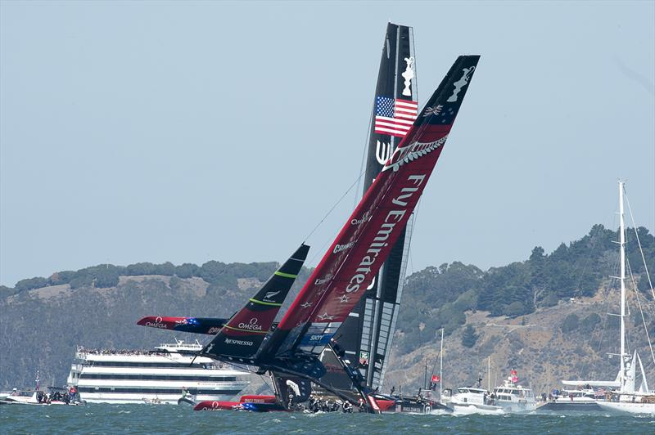
Success Story: Shoreside Power at Pier 70
Mitigation for the 34th America’s Cup & James Herman Cruise Terminal and Northeast Warf Plaza
Significant ROG & NOx impacts
EIR included many mitigation measures
Pollutant tons in 2013 | ROG | NOx | PM10 | PM2.5
Project Emissions in 2013 | 98 | 176 | 7 | 7
Thresholds | 10 | 10 | 15 | 10
Shoreside Power Reductions in 2013 | 11 | 215 | 6 | 6
Net Change in 2013 | +87 | -39 | +1 | +1
Notes:
1. EIR included many mitigation measures to reduce the effects of the project’s emissions:
Measures to reduce emissions from construction equipment, in-water, on-road and off-road
Measures to reduce marine emissions
Shoreside Power at Pier 27, the new cruise termination
Even with all of these mitigation measures there were still significant impacts.
2. Then we looked to off-site programs and the PORT had a project, which was to install shoreside power at Pier 70
3. Conducted an analysis of the emissions benefits of shoreside power in 2013 and as you can see here, there were significant benefits to Nox and PM reductions. Overall we still identified the impact as SU, even after accounting for all of the onsite mitigation largely because ROG emissions could not be reduced below threshold levels, they remained at 70 tons/year over the significance threshold.

Slide 3
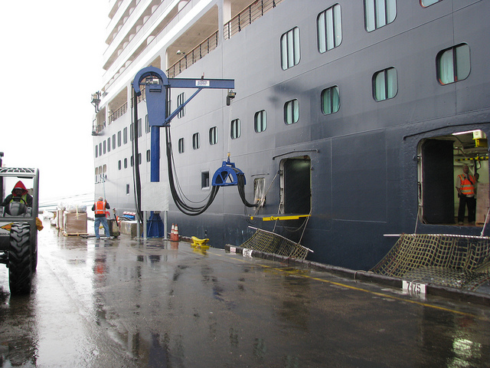
Success Story: Shoreside Power at Pier 70 installed in 2012
Average benefit for years 2012-2017
Shoreside power mitigation cost= $5.1 M
Costs for Other Types of Off-site Mitigation
Estimated Average Annual Emissions Reduction 2012-2017 (tons/year)
ROG | NOx | PM10 | PM2.5
7.6 | 151 | 3.6 | 3.6
Average cost/ ton of pollutant
ROG +NOx | PM
$32,156 | $1.4M
Offsite Mitigation | Cost
Species credit @ mitigation bank/ acre | $45,000
Wetland creation/acre | $500,000
Wetland enhancement/acre | $100,000
Riparian enhancement/per linear foot | $1,000
Notes:
1. Shoreside power installed in 2012, just in time before the America’s Cup event, so that the emissions reductions were occurred during the period of the project’s emissions.
2. Shoreside power benefits were quantified based on projected use, which was variable with 2013 and 2017 projected to be years of highest use. In periods of lowest use (2015) the benefits were projected as (tons/year):
ROG- 0.78
Nox- 15
PM10 & 2.5-0.3
3. This tells you that the emissions benefits per year can be variable. For America’s cup we were mitigating emissions primarily for two years 2012 and 2013, so we were not needing to mitigate operational emissions long term.
4. I also did a quick, basic calculation of what the average cost per ton of ozone precursor and PM levels would be. So what you see here is that the offsite mitigatin project did not really reduce PM emissions, but did significantly reduce ozone precursor or reactive organic gases and nox impacts. Whether this is an appropriate way to calculate a mitigation cost, is also a question.
5. So, how do these costs compare with other types of offsite mitigation costs?
Roughly of the same magnitude as acre of species credit at a mitigation bank
Less expensive than wetland creation or enhancement per acre.

Slide 4
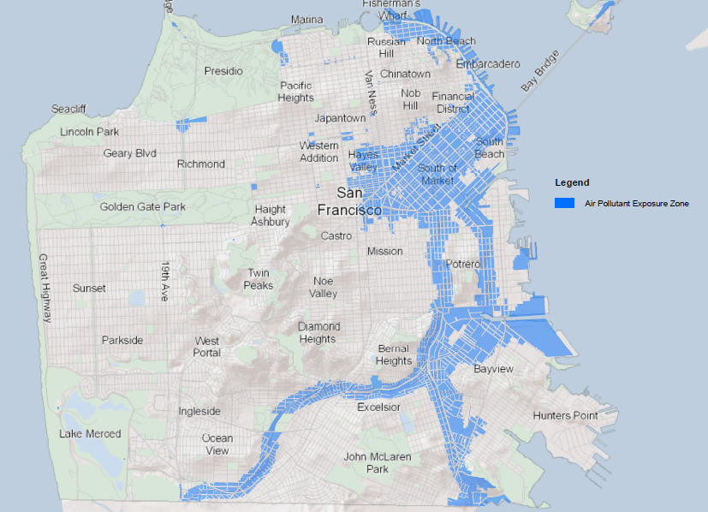
Developing a Local Off-site Mitigation Program
San Francisco is considering a local off-site mitigation program
Direct emissions reductions to areas of the City with increased health risks
Air Pollutant Exposure Zone
Cancer Risk >100/million or 90/million in Health Vulnerable Zip Codes
PM 2.5 >10.0 µg/m3 or > 9.0 µg/m3 in Health Vulnerable Zip Codes
All parcels within 500 feet of major freeways
Notes:
Why are we interested in developing an Offsite mitigation program:
1. We have a number of CEQA documents that call for off-site mitigation, if such mitigation projects can be identified:
Warriors, Pier 70, Mission Rock, Central SoMa EIRs. The mitigation measures suggest two means for mitigating the remaining impacts through an offsite program:
A. Payment to BAAQMD to fund an off-site mitigation program
B Fund a local off-site mitigation project
Central SOMA is a program EIR and the mitigation measure would only be required for project that exceed significance thresholds and cannot reduce emissions to less than significant with other mitigations that reduce the project’s direct emissions.
2. We would like to direct emissions reductions to projects in areas of the City with increased health risks. So, by reducing emissions locally, we hope to also reduce the health risk effects of air pollution locally. This program, conceptually, is being explored through our efforts to develop a Community Risk Reduction Plan, or essentially an air quality plan for San Francisco that looks at ways to reduce the burden of health effects.
Direct emissions reductions to areas of the City with increased health risks as mapped by the Air Pollutant Exposure zone. These are areas of San Francisco that experience increased exposure and health effects from air pollution. This zone is defined by the following criteria:
Excess Cancer risk from all modeled sources at or greater than 100/million. PM2.5 concentrations at or greater than 10.0 ug/m3
Excess cancer risk and PM2.5 standards lowered in “health vulnerable locations”
These are locations in the worst quintile of Bay Area Health vulnerability scores, zip codes 94102, 94103, 94105, 94124, and 94130 were afforded greater protection based on an assessment of hospitalization rates for air pollution related causes. For these areas, the cancer risk standard was lowered to 90/million and the PM2.5 standard lowered to 9.0 ug/m3.
Added all parcels within 500 feet of major freeways that weren’t already captured by the modeling based on substantial evidence from the CARB’s Land Use handbook that pollutant concentrations were greatest within 500 feet of major freeways and drop off to background levels at around 1,000 feet from freeways.

Slide 5
Projects Explored through Local Off-site Mitigation Program
Light Rail Vehicle Program | Level 2 Charging Stations at SFO | No generator pilot
Medium Duty Distribution Truck Electrification Pilot | EV Distribution Van Pilot at Produce Market | Future bus fleet acquisition program
School Bus | Better Roofs Program | Muni facility upgrade projects
Fast-charging stations for EV TNCs | Boiler replacements in City Buildings | Clean power transmission line on 3rd Street
Expand bikeshare to disadvantaged communities | Generator replacements in City Buildings | Replace diesel-powered Port vehicles (garbage trucks, etc.)
Hyde Street fisherman fleet and truck electrification and engine replacement | Natural gas replacement using electricty hot water heaters | Shoreside power at Pier 80
Vansharing services | Zero natural gas pilot | Electric bike bikehsare pilot
Notes:
We have partnered with staff from other City departments to explore projects that could be candidates for an offsite mitigation program. These projects would need to meet all of the criteria that Honey discussed in her presentation. So far, we are finding shoreside power to be the most worthwhile offsite mitigation.
1. Replacement of emergency standby generators doesn’t seem to effectively reduce emissions enough to make a dent into a project’s offset requirement
2. Some of these programs are difficult to quantify, such as vansharing, and bike sharing. There would need to be some evidence to support that such programs are resulting in a mode shift that reduces emissions. For example, a vansharing or biksharing program could reduce some vehicle trips, but maybe those people would have taken transit if the vansharing option weren’t there.
3. San Francisco has already made considerable effort to reduce it’s fleet emissions- all remaining diesel buses in Muni’s fleet run on renewable diesel which reduces PM by about 30%.

Slide 6
Challenges in Identifying an Off-site Mitigation
What projects or programs are available?
What is the right fee?
Does the offsite project achieve significant emissions reductions?
Notes:
What projects or programs are available?
Mitigation must be in addition to existing regulatory requirements. There are a lot of regulations that require fleet or equipment turnover.
Mitigation must not already be part of an existing funded project (does not include payment to purchase clean vehicles that have approved funding)
Project must result in reduced emissions in the Air Basin if you are mitigating regional air pollutants
An even bigger challenge for us is not only reducing emissions in the Air Basin, but trying to reduce them in a relatively very small geography (SE SF) in a city that already has done so much to reduce emission. It may not be as challenging in places that still have low hanging fruit
What is the right fee?
Warriors EIR= $18,030/ton based on Carl Moyer Program
Air District Board Recommendation (2016)=$34,623/ton ozone precursor; seems to be in alignment with the ozone precursor cost/ton for shoreside power that I listed previously, which was about $32K.
Does the offsite project achieve significant emissions reductions?
Emergency generator replacement projects may not significantly reduce emissions due to lack of operation & replacement costs are high

Slide 7
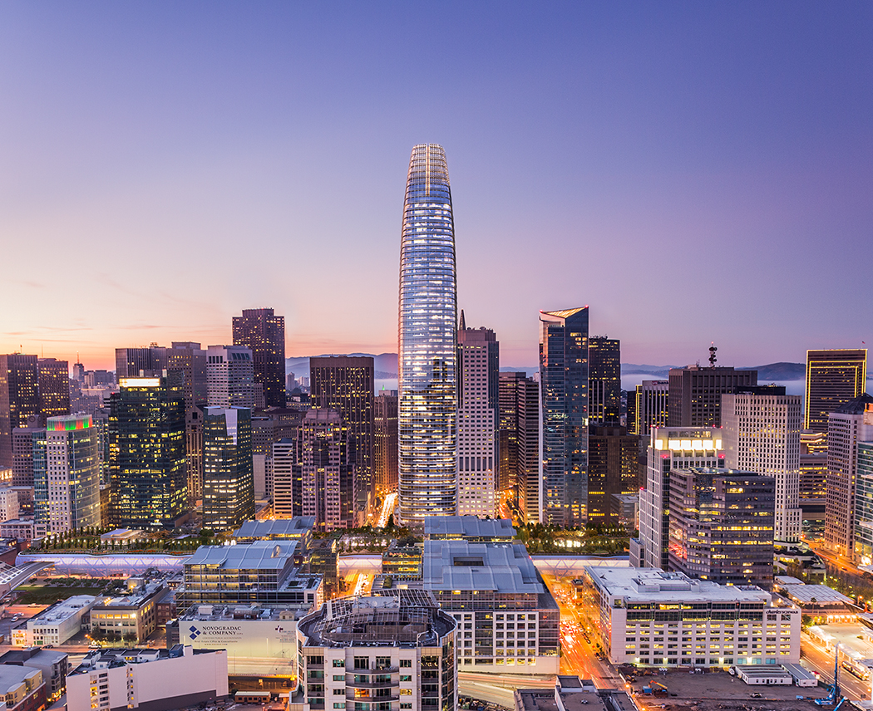
THANK YOU
Jessica Range
Senior Environmental Planner
San Francisco Planning
Jessica.Range@sfgov.org
www.sfplanning.org

Slide 8
Panel & Audience Discussion
What is the remedy if an Offsite Project does not end up meeting its anticipated reductions?
How do you mitigate operational emissions that last decades into the future?
Does CEQA allow for you to pre-mitigate for future year emissions?
Can a lead agency bank unused emissions reduction for future projects to pay into?
If an off-site mitigation project exists, can it fully mitigate operational impacts to less than significant?
Notes:
1. What is the remedy if an Offsite Project does not end up meeting its anticipated reductions?
Allow for a project to make up its emissions reductions through another program/project in a future year?
Maintain a reserve of projects, that a sponsor can pay in to for additional reductions?
Increase the mitigation ratio from 1:1 to 1.5:1 or 2:1 to ensure that the project will in fact reduce necessary emissions?
Design a program such that you have a pool of projects and the fee and corresponding reduction in emissions are averaged?
2. For projects required to mitigate operational emissions:
Can you define a life of a project? 40 years? 60 years? 100 years?
How do you account for increased regulations that may reduce the offsite mitigation requirement if future years?
3. Does CEQA allow for you to pre-mitigate for future emissions?
4. Can a lead agency bank unused emissions reduction for future projects to pay into?
5. If an off-site mitigation project exists, can it fully mitigate operational impacts to less than significant?
Construction impacts may be more easy to fully mitigate because project needs to only produce benefits for a finite period of time
Operational impacts may be more difficult to mitigate

Slide 9
CEQA Mitigation: General Concepts
CEQA Guidelines Section 15370
“Mitigation” includes:
(a) Avoiding the impact altogether
(b) Minimizing impacts by limiting the degree/ magnitude of the action
(c) Repairing, rehabilitating, or restoring the impacted environment
(d) Reducing or eliminating the impact over time
(e) Compensating for the impact
Offsite mitigation (compensatory) used when impacts cannot be mitigated by the project through other options
CEQA Guidelines Section 15041. Authority to Mitigate
Nexus and rough proportionality
For housing development: a lead agency shall not reduce the number of housing units as a mitigation measure if other feasible mitigation would provide a comparable lessening of the significant effect
Notes:
This is a backup slide. Not planning to discuss as this will be discussed by Andrea.

