Slide 1


Affordable Housing & Sustainable Communities Program
Success Stories
August 3rd, 2018 | AEP Institute

Slide 2
AHSC Overview & Goals

Slide 3

California Climate Investments: Statutory Requirements
1. Reduce GHG emissions
3. Maximize economic, environmental, and public health benefits to the State
2. Direct investment toward the most disadvantaged communities in the State

Slide 4
AHSC Program Goal
To fund projects that result in:
the reduction of greenhouse gas (GHG) emissions and vehicle miles traveled (VMT) and
increased accessibility of housing, employment centers and key destinations
through low-carbon transportation options such as walking, biking and transit.

Slide 5
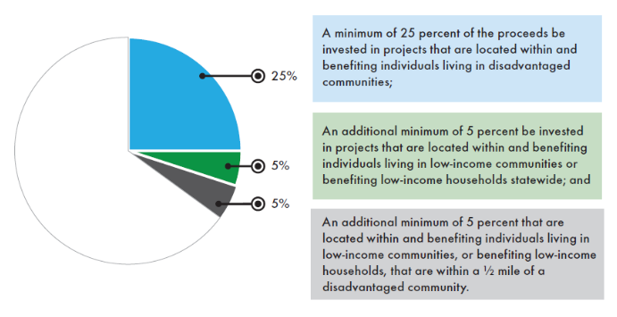
Disadvantaged Communities &
Low-income Communities Investments
  Senate Bill 535 and Assembly Bill 1550 Implementation
Notes:
Senate Bill 535 directs State and local agencies to make investments that benefit California's disadvantaged communities. It also directs CalEPA to identify disadvantaged communities for the purposes of these investments based on geographic, socio-economic, public health, and environmental hazard criteria.
Assembly Bill 1550 increased the percent of funds for projects located in disadvantaged communities from 10 to 25 percent and added a focus on investments in low-income communities and households.
California Climate Investments projects selected after release of the 2017 Draft Funding Guidelines will use AB 1550 definitions for disadvantaged communities, low-income communities, and low-income households.

Slide 6
Statutory Set Asides
50% of available funds for Affordable Housing
50% of available funds to Disadvantaged Communities

Slide 7
What does it fund?
Eligible Capital Projects 1. Affordable Housing Development (loan) Bricks and Mortar 2. Housing-Related Infrastructure (grant) Required as Condition of Approval 3. Sustainable Transportation Infrastructure (grant) Transit, Bike Lanes, Sidewalks 4. Transportation-Related Amenities (grant) Bike Parking, Repair Kiosks, Urban Greening, Bus Shelters | Eligible Programs (3 Year Grants) 1. Active Transportation Programs 2. Transit Ridership Programs

Slide 8
Eligible Project Types
TOD Transit Oriented Development | ICP Integrated Connectivity Project | RIPA Rural Innovation Project Area
Required: High Quality Transit Affordable Housing | Required: Qualifying Transit Sustainable Transportation Infrastructure | Required: Qualifying Transit Sustainable Transportation Infrastructure
Required: At least one additional components from the following: Sustainable Transportation Infrastructure Transportation Related Amenities Programs | Required: At least one additional components from the following: Affordable Housing Transportation Related Amenities Programs | Required: At least one additional components from the following: Affordable Housing Transportation Related Amenities Programs
Required Minimum Density: 30 units/acre | Required Minimum Density: 20 units/acre | Required Minimum Density: 15 units/acre

Slide 9
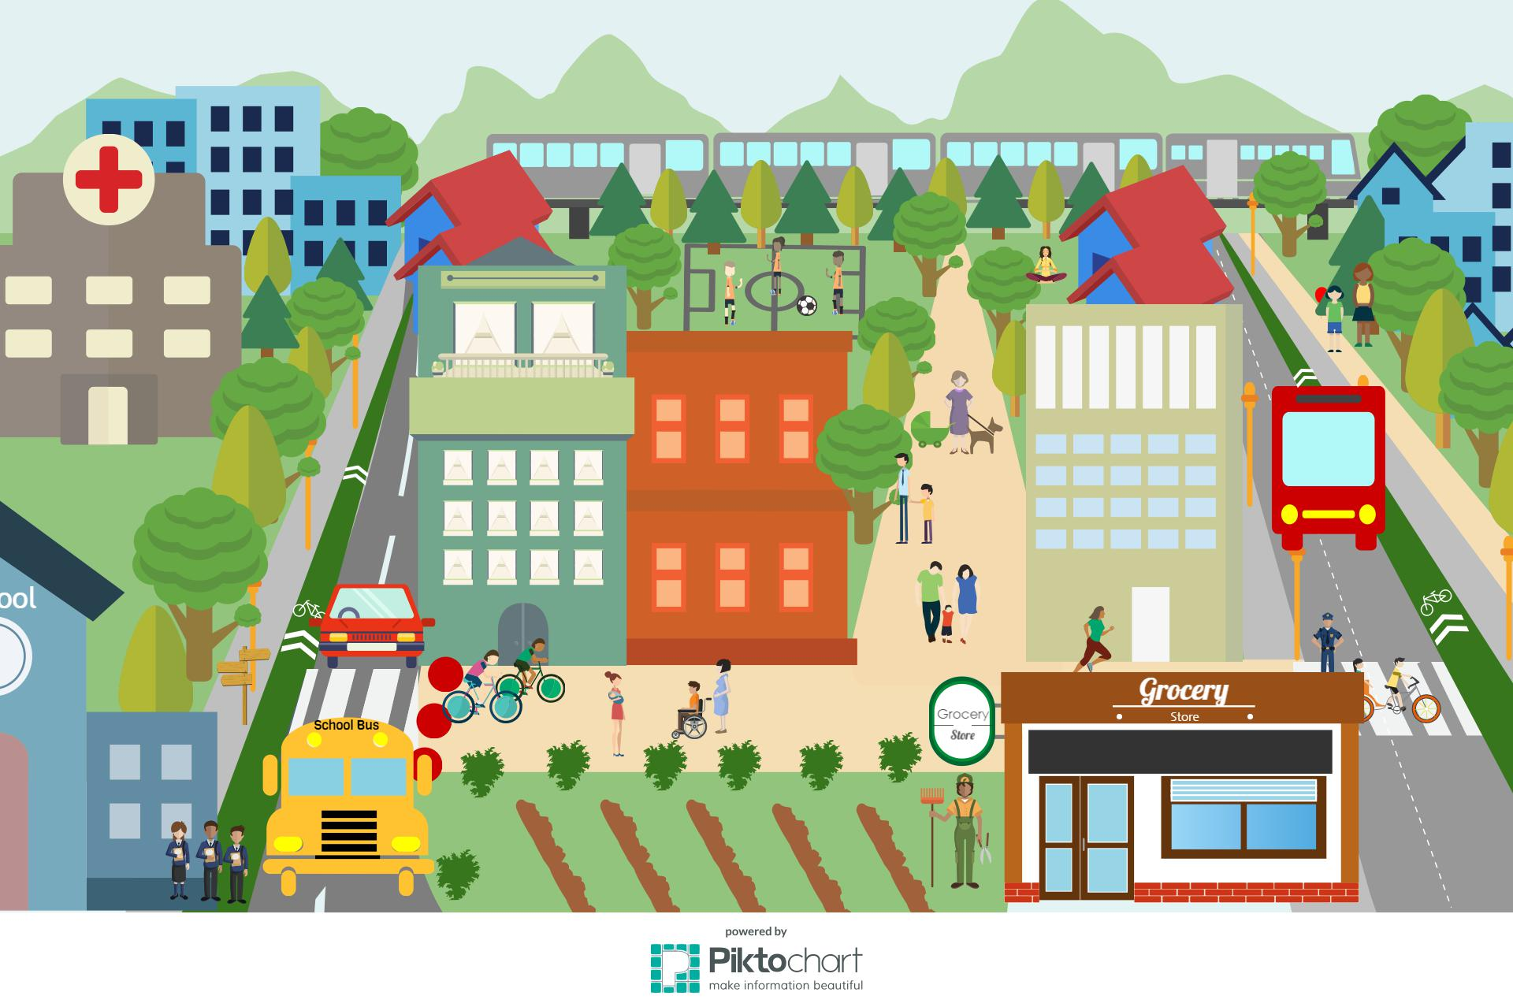
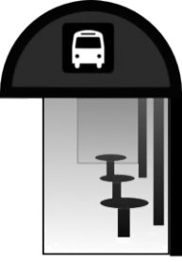
Affordable Housing
Urban Greening
Sidewalks
Bus Shelters
Expansion of Bus Routes
Bike Lanes
Pedestrian Pathways
Image Credits- Produced in Piktochart by SGC Staff

Slide 10
Who is Eligible to Apply?
Eligible Applicants
Local Governments (City, County, City/County) | Local Transportation Agencies | Public Housing Authority
Transit Agency or Operator | Regional Transportation Planning Agency | Congestion Management Agency
Joint Powers Authority | School District | Facilities District
University or Community College District | Developer: Public, Private, or Nonprofit | Program Operator: Public, Private, or Nonprofit
Federally Recognized Indian Tribes

Slide 11
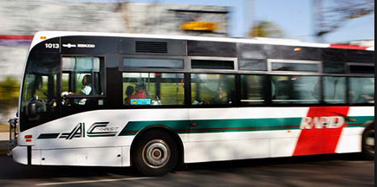
Thresholds
  Transit Station/Stop within ½ mile of AHD
  Demonstrate VMT reduction
  Sustainable Communities Strategy Implementation
  Agricultural Land Preservation
  Urban Greening Components
  Transit Passes for Residents
  “Smoke Free” Buildings
  Adequate Lighting for Public Spaces
  Affordability Threshold

Slide 12
AHSC Scoring Criteria
AHSC Scoring Elements and Criteria
Criteria | Points
GHG Quantification Methodology Scoring
GHG Efficiency | 15
GHG Total | 15
Quantitative Policy Scoring
Active Transportation Improvements | 10
Green Buildings and Renewable Energy | 10
Housing and Transportation Collaboration | 10
Location Efficiency and Access to Destinations | 5
Funds Leveraged | 5
Programs | 3
Anti-Displacement Strategies | 5
Local Workforce Development and Hiring Practices | 2
Housing Affordability | 5
Narrative-Based Policy Scoring
Collaboration & Planning | 6
Community Benefit & Engagement | 6
Community Climate Resiliency | 3
Total Scoring | 100

Slide 13
AHSC Successes to Date

Slide 14


AHSC Program Accomplishments
79 Projects totaling over $687 Million of investments funded across state in first three rounds starting in 2015
~6,170 Affordable Units
~1.6 Million Metric Tons of C0₂

Slide 15
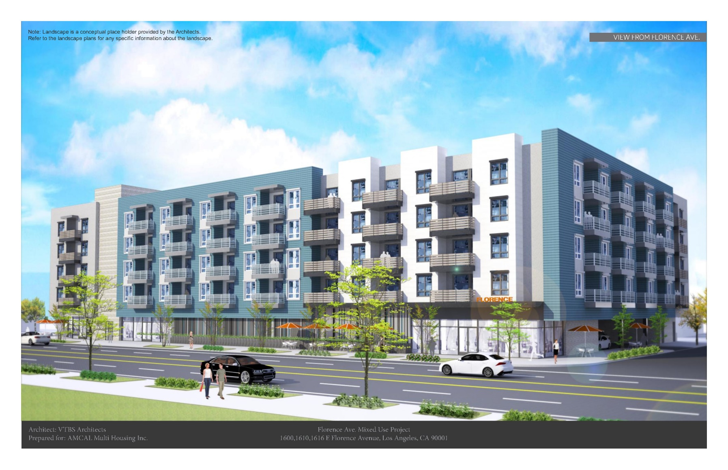
Florence Neighborhood Mobility
TOD Project – County of Los Angeles
Project Details
96-100% DAC 108 affordable housing units for 30-60% AMI 100% Affordable Density: 117 units/acre 54 units set aside for those at risk of homelessness; workforce development center
Transportation Service: Bikeway and walkway improvements Creates a walking path in local park that enhances stormwater capture
AHD: $7,027,908 STI: $3,020,230 TRA: $622,435 Program: $127,495 Total Award amount: $10,798,068

Slide 16
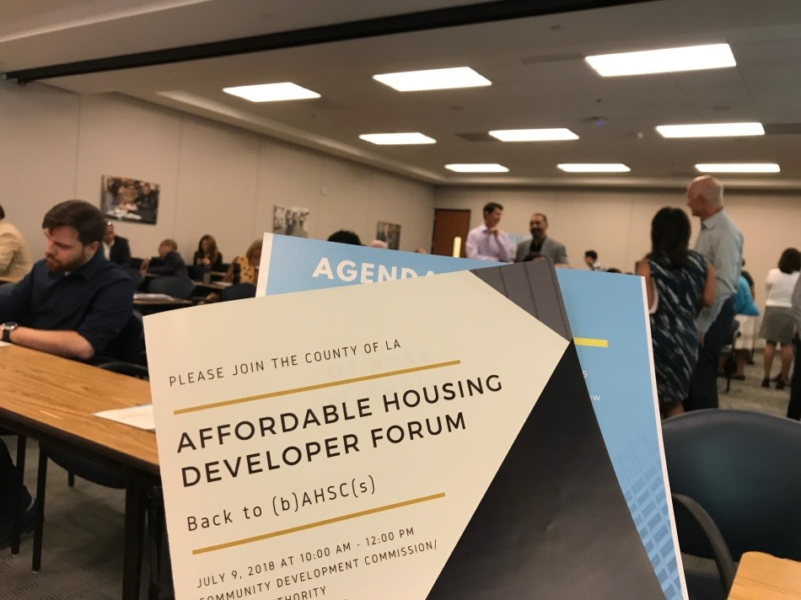
Source: LA County, http://ahsc.lacounty.gov/
Notes:
LA County Chief Exec Office and Community Dev. Commission/Housing Authority organized working group for all needed partners in County—brought in DPW, DPH, Dept. Regional Planning, Dept. of Mental Health
Worked closely with developers and county partners to design and follow through on projects

Slide 17
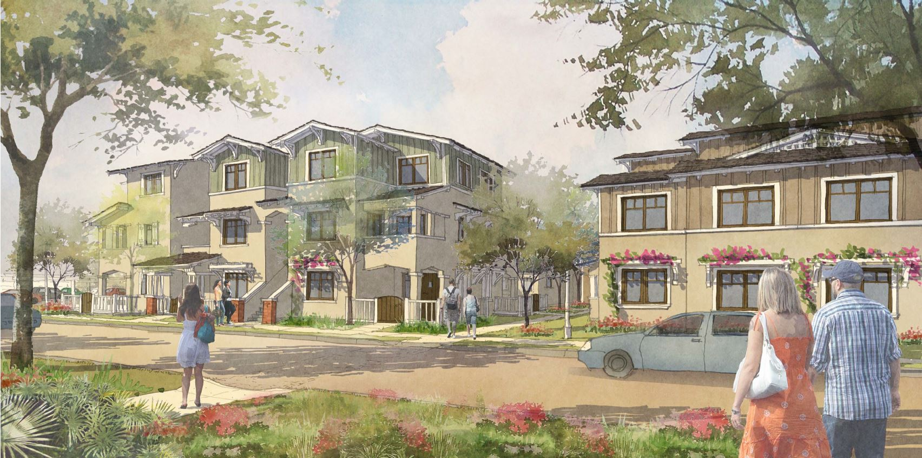
Arrowhead Grove 2 & 3
ICP Project – City of San Bernardino
Project Details
91-95% DAC 147 affordable housing units for 30-60% AMI 22 one-bedroom 81 two-bedroom 34 three-bedroom 10 four-bedroom 80% Affordable Community center with social services
Transportation Service: Bikeway and walkway Half-mile of safe and accessible walkways that will connect housing to local Elementary school
AHD: $17,422,714 STI: $1,865,264 PGM: $253,300 Total Award amount: $20,000,000
Notes:
Inland Empire region faced concerns about density requirements and their impacts on cost in previous rounds
In Round 3, slightly softened density requirements to allow more projects to be eligible
National CORE + City of San Bernardino worked to create application to fund 2 phases of redevelopment of existing public housing; created great transportation improvements
We hope to see

Slide 18
Mountain View Village
RIPA Project –Lamont, Kern County
Project Details
40 affordable housing units for 30-60% AMI 9 extremely low-income units Zero-net energy development
Transportation Service: bike lanes and sidewalks 2 miles of sidewalks, 3 miles of bike lanes Van share service to employment centers, bike sharing and education programs Leveraging CalTrans SHOPP grant
AHD: $6,053,997 STI: $2,065,688 TRA: $20,000 PGM: $86,565 Total Award amount: $8,226,250
Notes:
R1: Advocates pushed for this funding to be accessible to rural applicants, deep need for housing and transportation. R2 created rural set-aside; R2 & 3 funded 9 projects throughout state, such as this Dinuba project
Lamont: After project was not awarded, project developers, Lamont Chamber of Commerce, multiple community-based organizations, elected officials, and residents came together to form the Affordable Housing Coalition of Kern County
Held several meetings w/ coalition as well as with residents in an extensive planning process in order to design scope of project to meet community needs—in response to resident’s comments, building changed to ZNE to eliminate energy costs for residents, created more bike lane and sidewalk connectivity

Slide 19
Questions? coral.abbott@sgc.ca.gov

Slide 20
Affordable Housing & Sustainable Communities Program
Success Stories
August 3rd, 2018 | AEP Institute

